Slide 1

Dynamic Weather Forecast
Presented By:
Shivansh Puri-Graphic Era Deemed To Be University-B.Tech CSE

Slide 2
Outline
Problem Statement
System Development Approach
Algorithm & Deployment
Result
Conclusion
Future Scope
References

Slide 3
Problem Statement
Users need real-time, location-specific weather information.
Current weather data is often scattered and not easily accessible.
Users require a simple, intuitive interface for daily planning and travel.
Users often waste time checking multiple sources to get complete weather information.
Lack of personalized and location-aware weather updates reduces convenience and planning efficiency.

Slide 4
System Development Approach
Frontend Technologies:
HTML5 – Provides the structure of the dashboard, including sections for current weather, hourly forecast, weekly forecast, search bar, and recent locations.
CSS3 – Handles styling, responsive layouts, and visual enhancements like cards, icons, hover effects, and weather boxes.
Bootstrap 5 – Pre-built components and grid system for mobile-responsive design and consistent styling.
JavaScript – Adds dynamic interactivity: fetching API data, displaying current/hourly/weekly weather, search suggestions, geolocation detection, and recent location management.

Slide 5
System Development Approach
API Integration:
OpenWeatherMap API – Fetches current weather, hourly and weekly forecasts, UV index, and air quality data.
Geolocation API – Detects user’s current location to provide automatic weather updates.
Storage & State Management:
Local Storage – Stores recent locations

Slide 6
System Development Approach
Design Approach:
Clean and user-friendly interface – Weather data displayed using cards, icons, and easy-to-read typography.
Mobile-responsive design – Works on desktops, tablets, and smartphones seamlessly.
Modular separation of files – HTML, CSS, and JS are separated for maintainability, readability, and scalability.
Interactive and real-time updates – Search suggestions, recent locations, and live weather updates enhance usability.
Error handling & fallback – Handles invalid cities, API errors, and geolocation permission denials gracefully.

Slide 7
Algorithm & Deployment
Location Detection & Data Fetching
Geolocation API: Detects user’s current location automatically upon visiting the dashboard.
City Search & Auto-Suggestions: User can search any city; suggestions are fetched from OpenWeatherMap Geocoding API in real-time.
Weather API Calls: Fetch current weather, hourly forecast, 7-day forecast, UV index, and air quality using OpenWeatherMap API.
Frontend Design
Layout using HTML & Bootstrap: Responsive layout with navigation bar, search section, current weather, hourly forecast, and weekly forecast cards.
Weather Cards: Current weather, hourly, and weekly forecasts displayed in cards with icons for intuitive visualization.
Recent Locations Section: Displays the last 6 searched locations in clickable cards for quick access.

Slide 8
Algorithm & Deployment
Interactive Features
Dynamic Rendering with JavaScript: Updates dashboard content in real-time without page reload.
Error Handling: Handles invalid city inputs, API errors, or denied geolocation permissions gracefully.
Case-Insensitive Recent Locations: Prevents duplicate entries like "Delhi" and "delhi".
Hourly & Weekly Forecasts: Shows next 24 hours and 7 days forecast dynamically with weather icons.
Search Suggestions: Fetch and display city suggestions as the user types for better UX.

Slide 9
Algorithm & Deployment
Testing
Cross-Browser Compatibility: Verified on Chrome, Firefox, and Edge.
Mobile Responsiveness: Fully responsive using Bootstrap grid and flex utilities, ensures usability across phones, tablets, and desktops.
API Error Testing: Handles failed or invalid API responses without breaking UI.
Deployment
Static Hosting: Can be deployed on GitHub Pages for free access.
Real-Time Data Updates: Dashboard fetches live data on load and updates dynamically.
Secure API Key Handling: API key stored safely in JS and used for authorized requests.

Slide 10
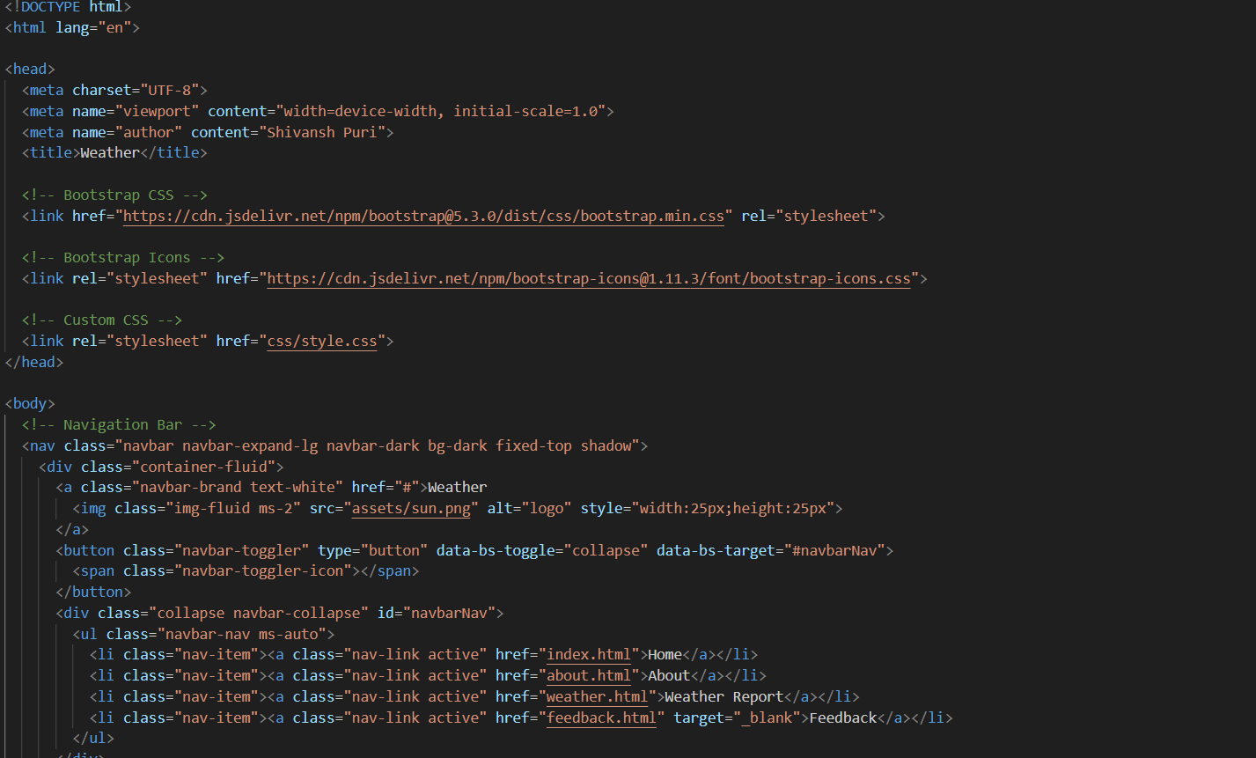
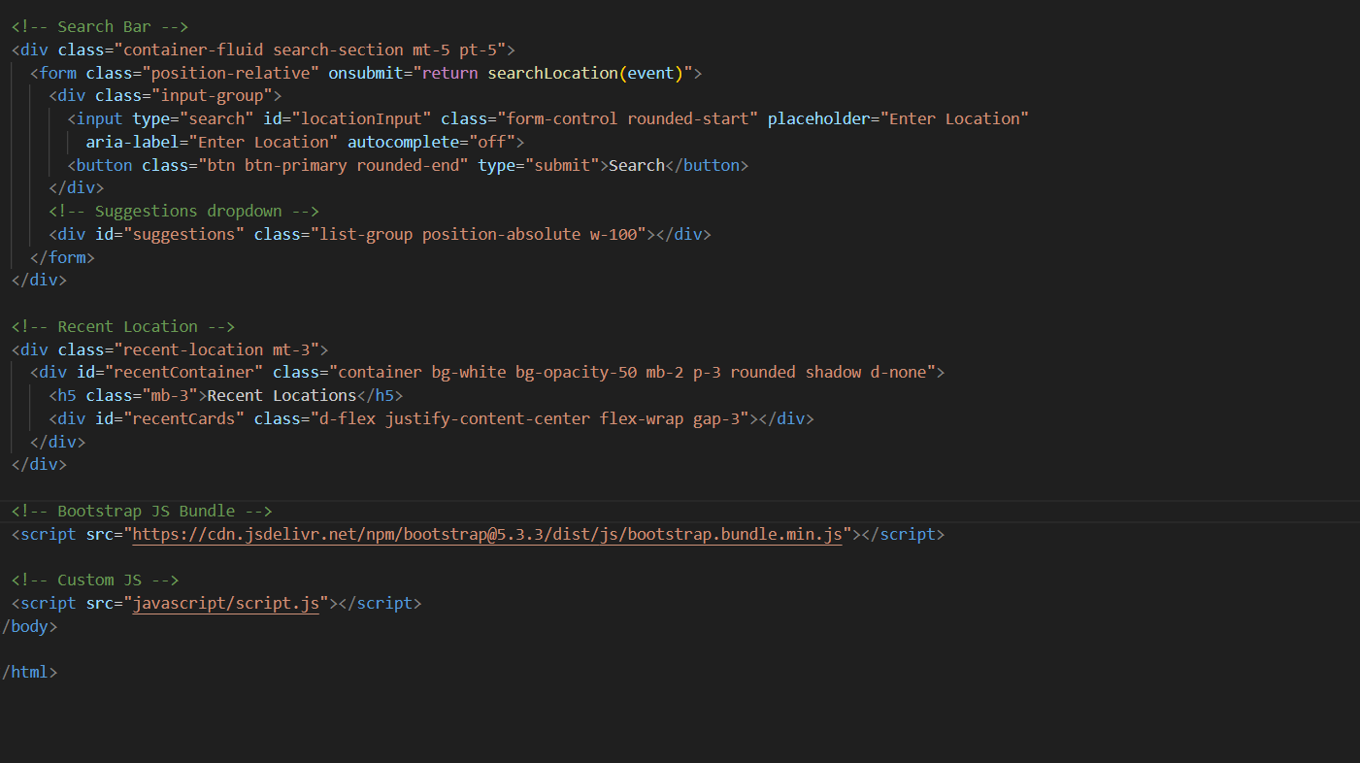
Result
Index.html

Slide 11
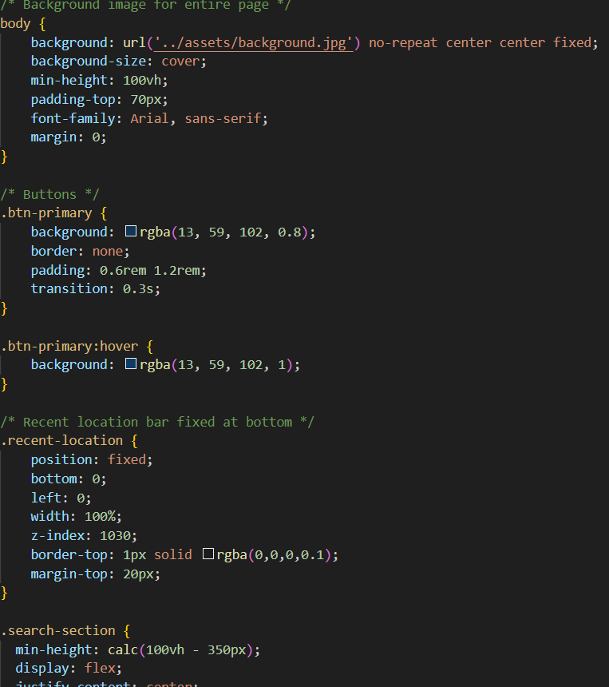
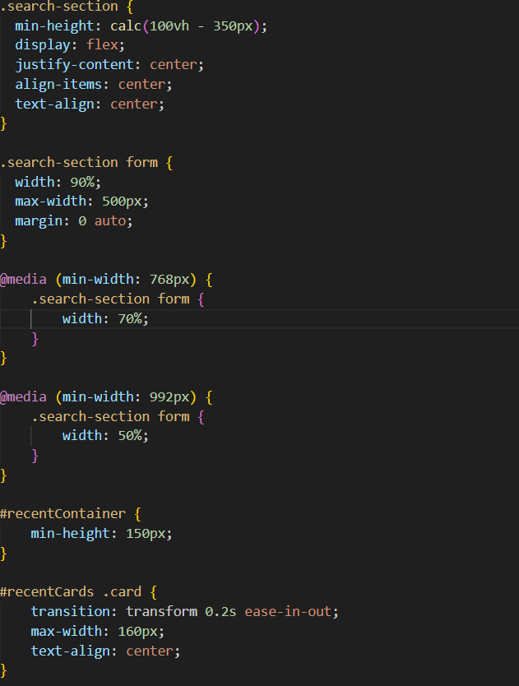
style.css

Slide 12
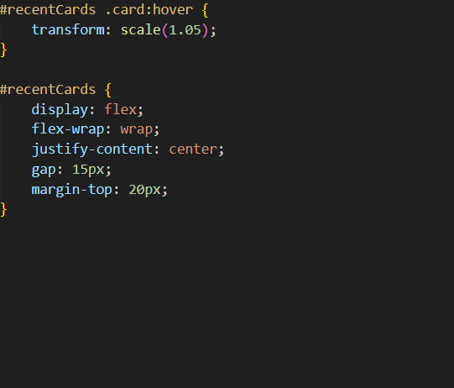
style.css

Slide 13
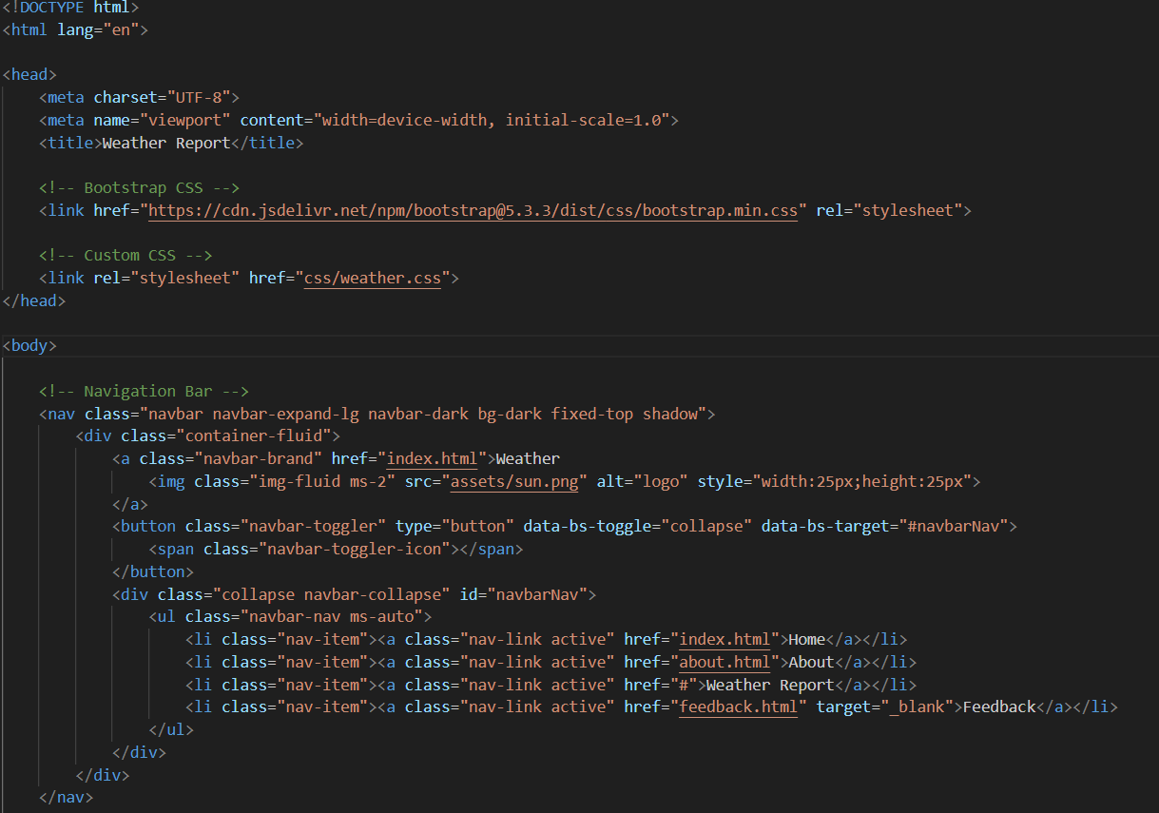
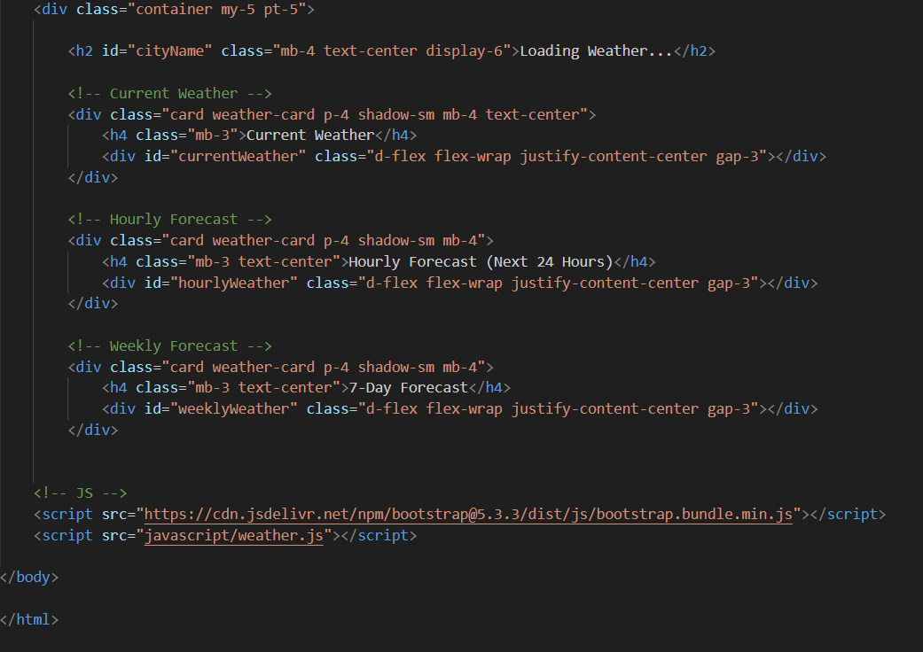
weather.html

Slide 14
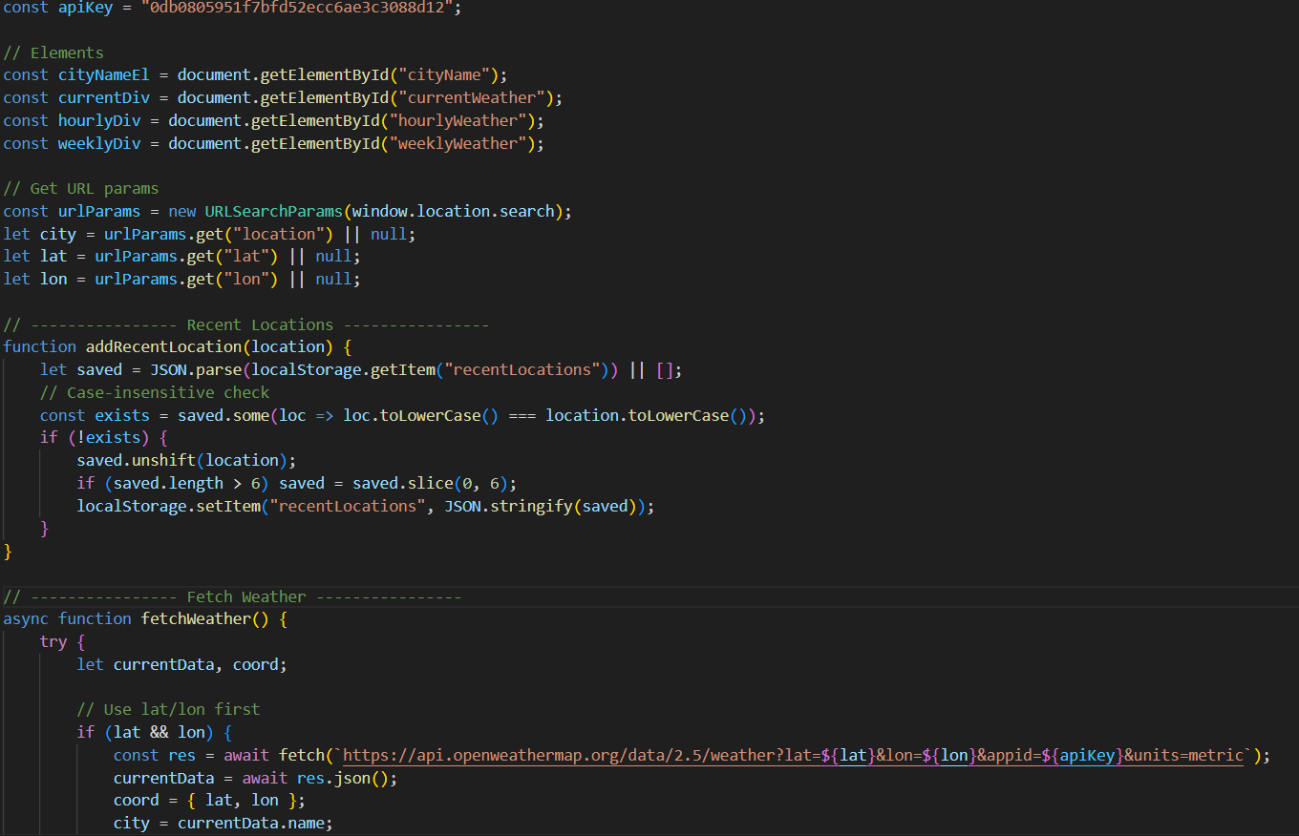
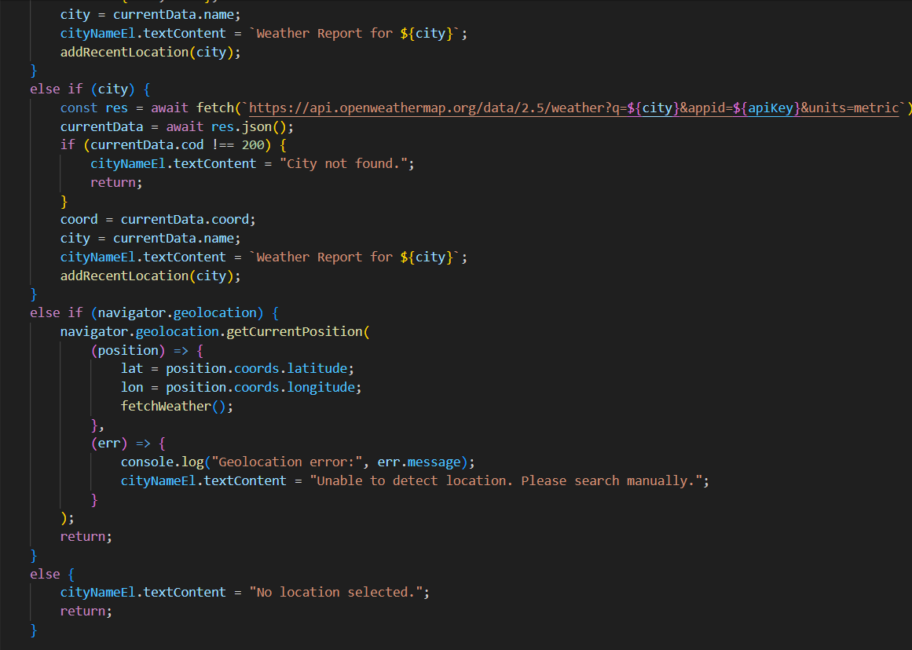
weather.js

Slide 15
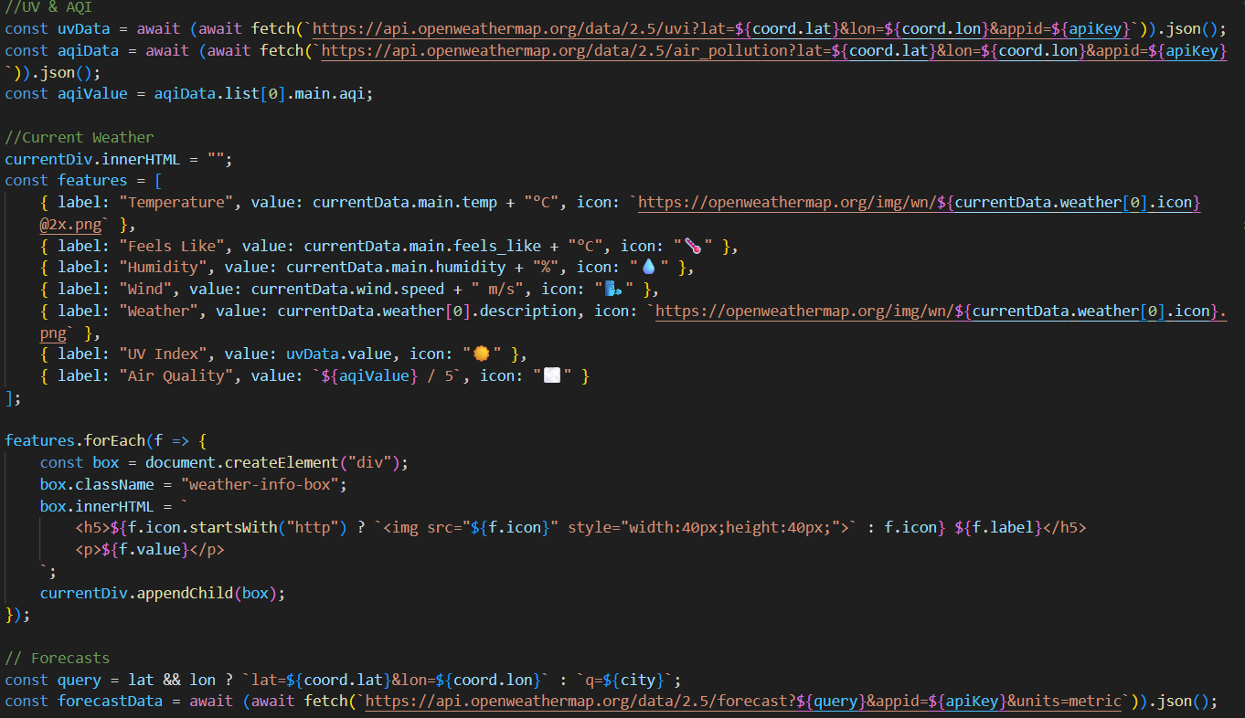
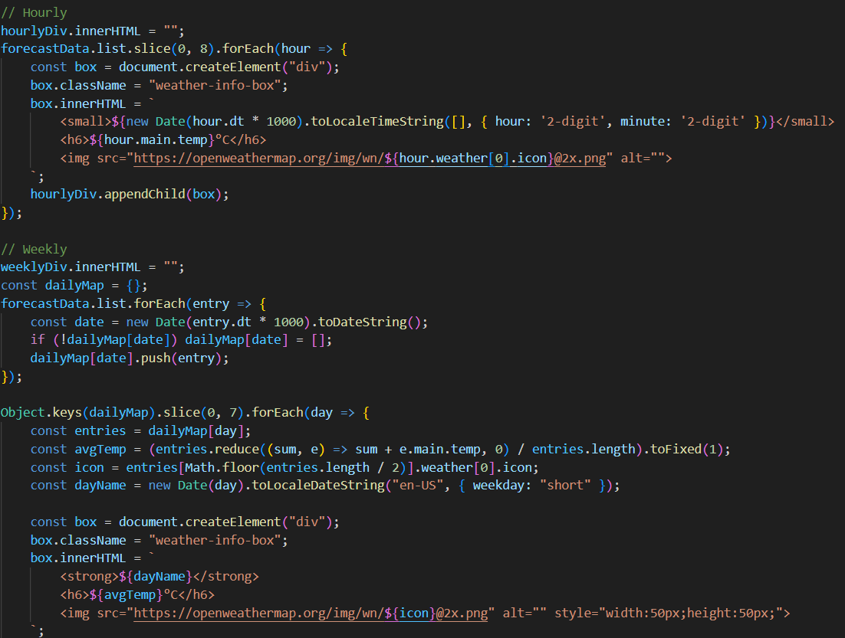
weather.js

Slide 16
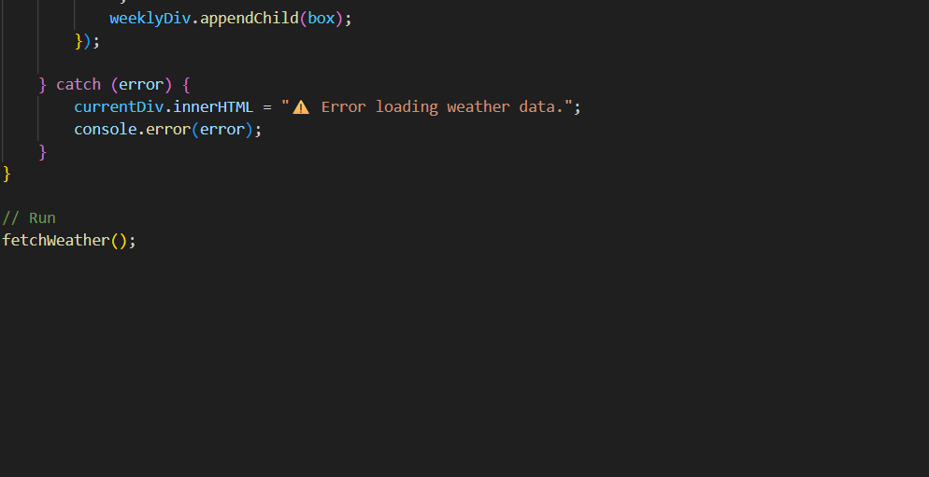
weather.js

Slide 17
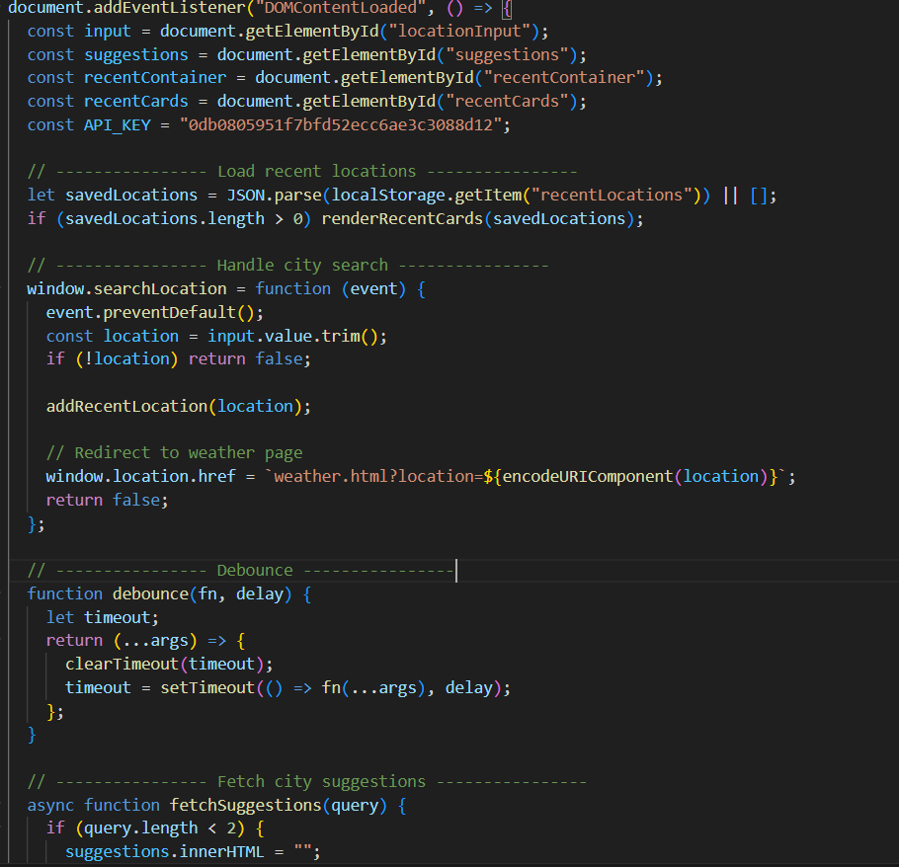
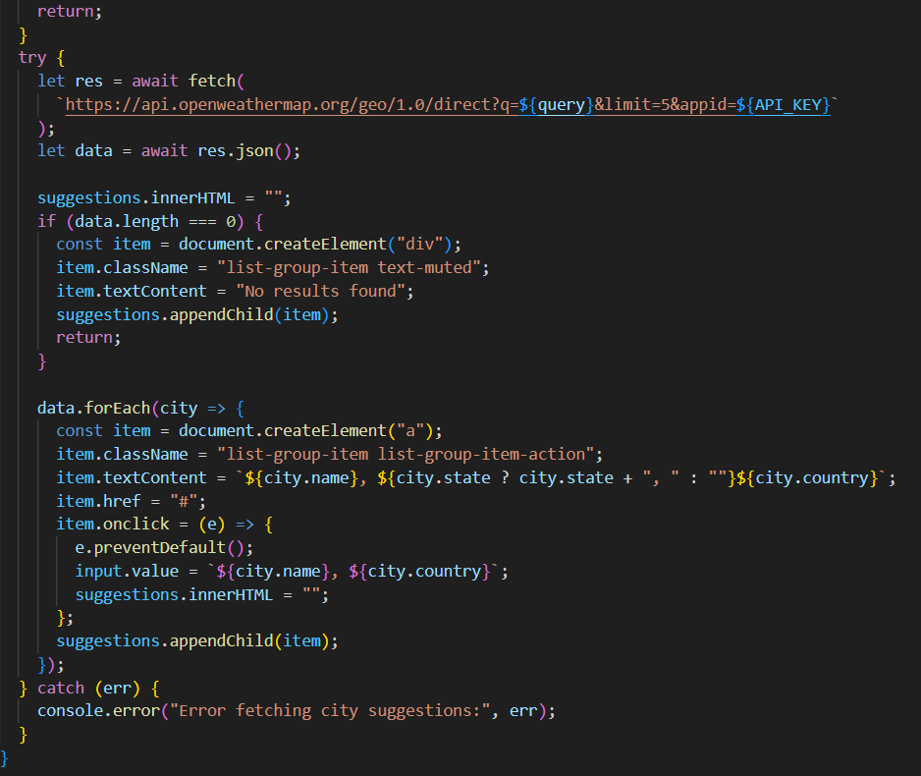
script.js

Slide 18
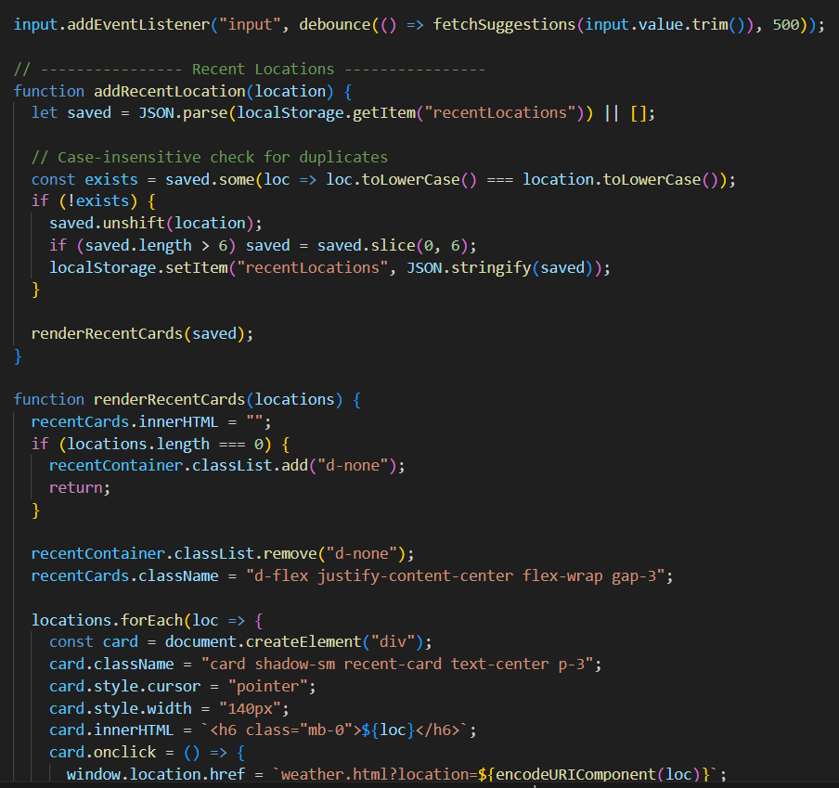
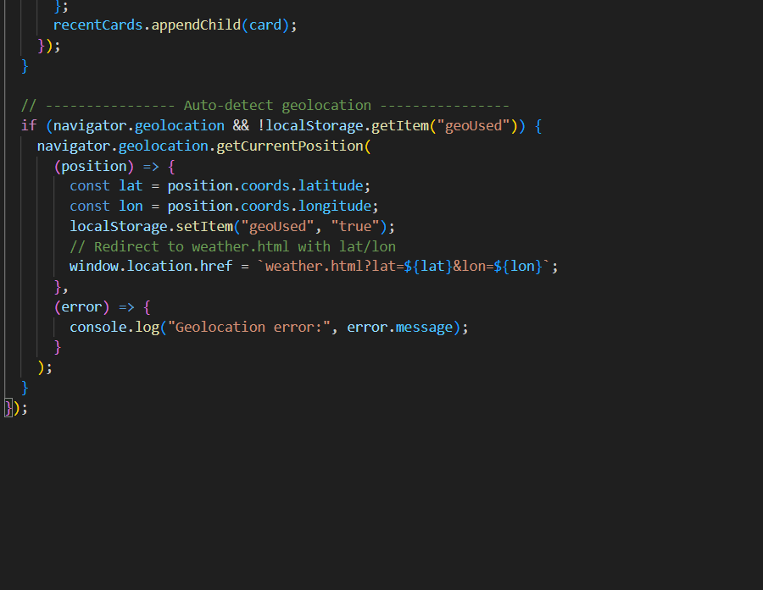
script.js

Slide 19
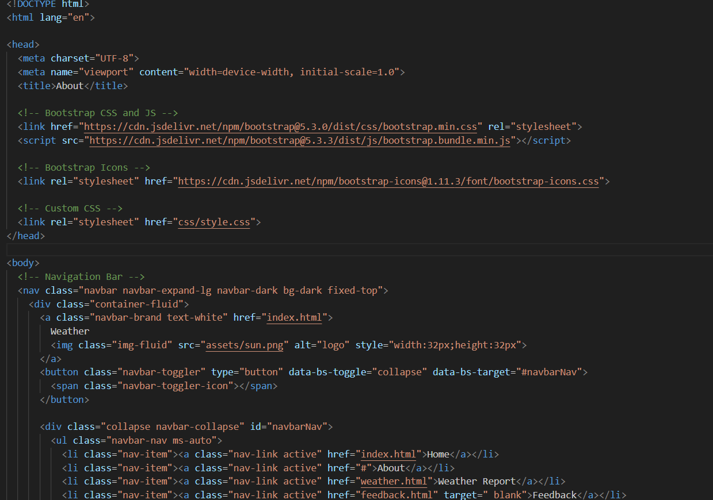
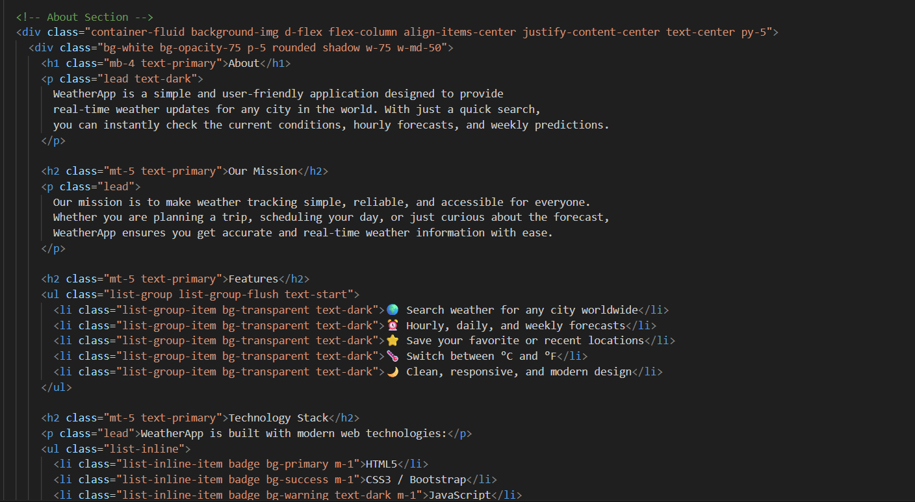
about.html

Slide 20
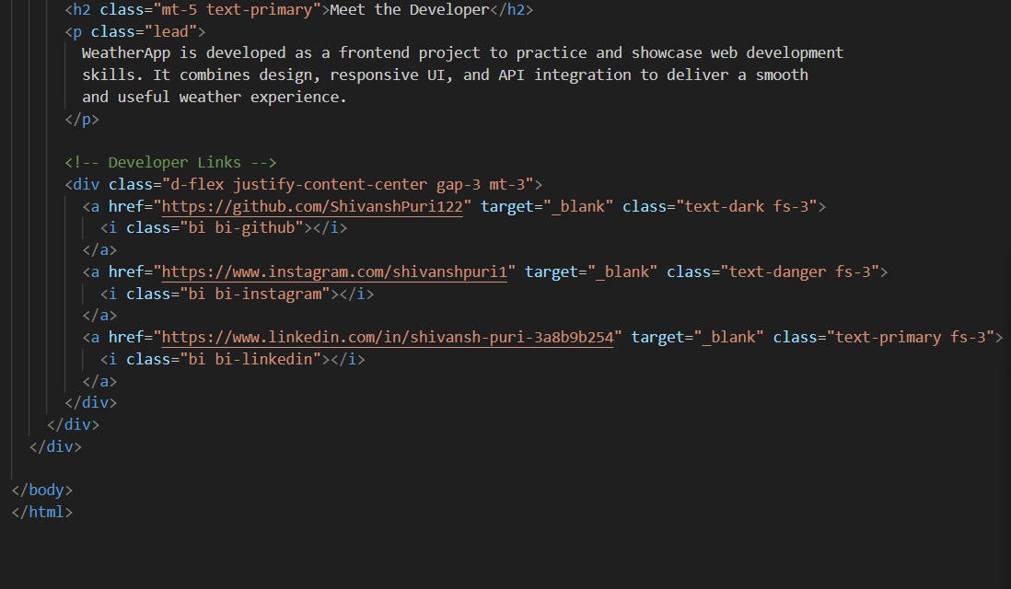
about.html

Slide 21
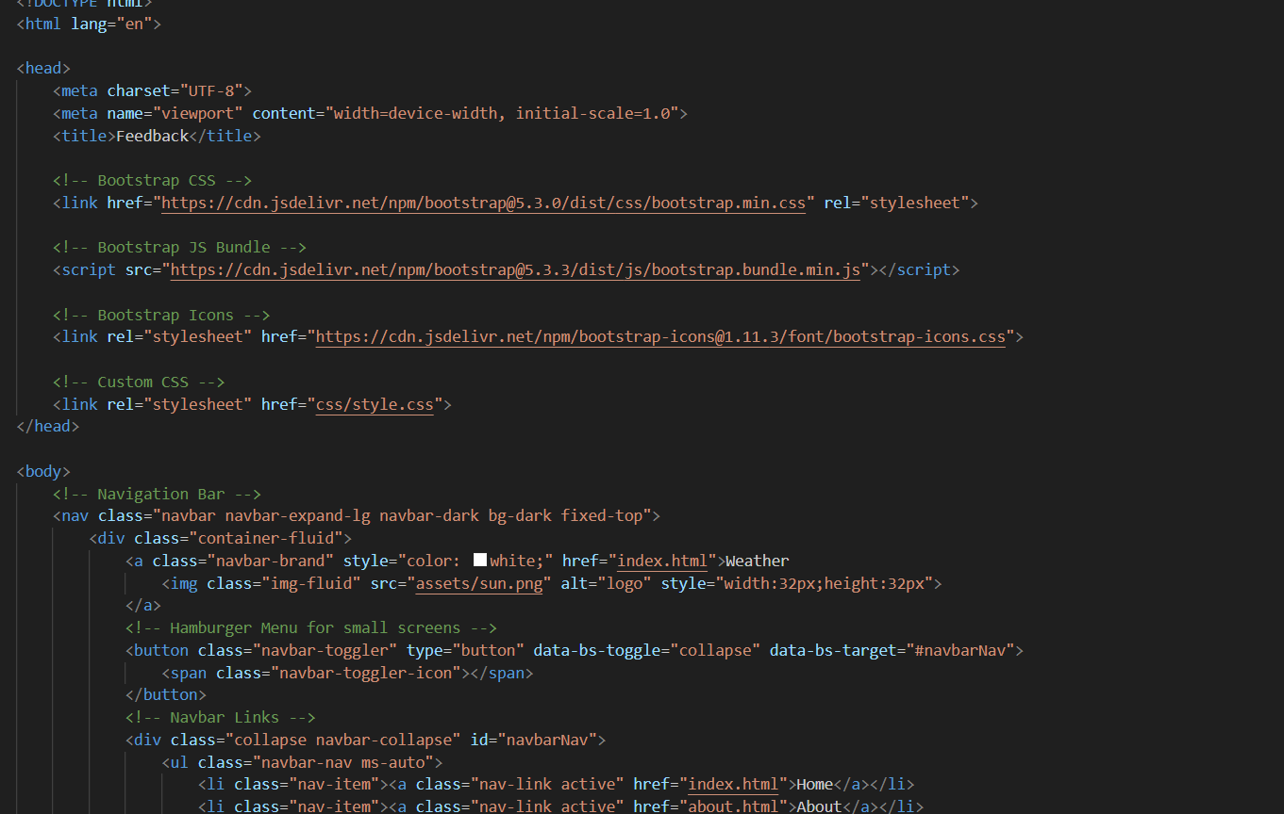
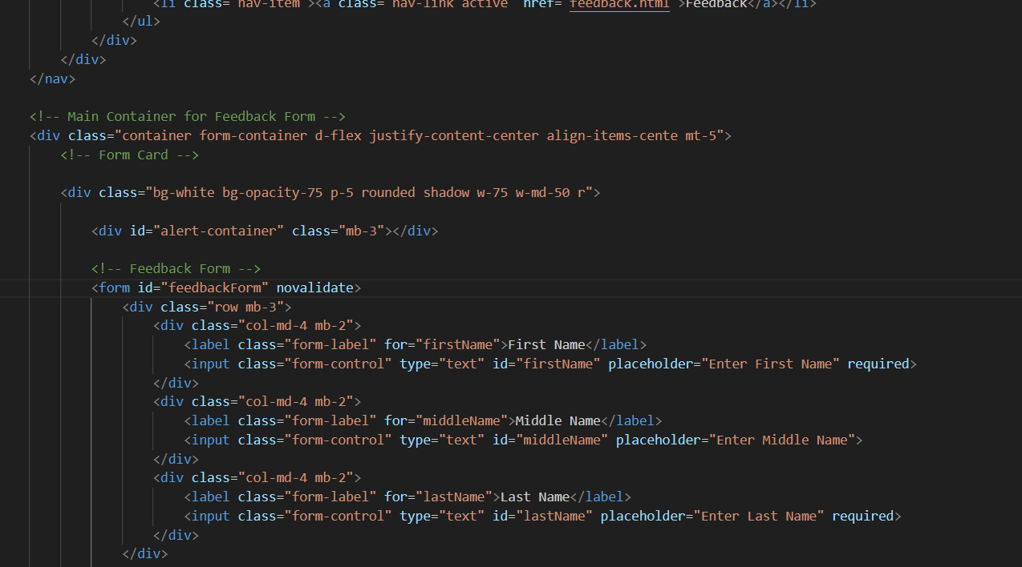
feedback.html

Slide 22
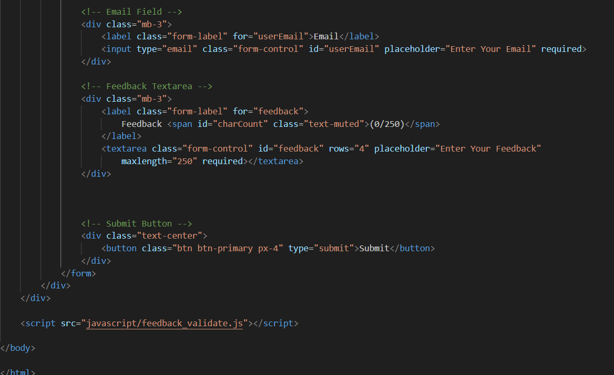
feedback.html

Slide 23
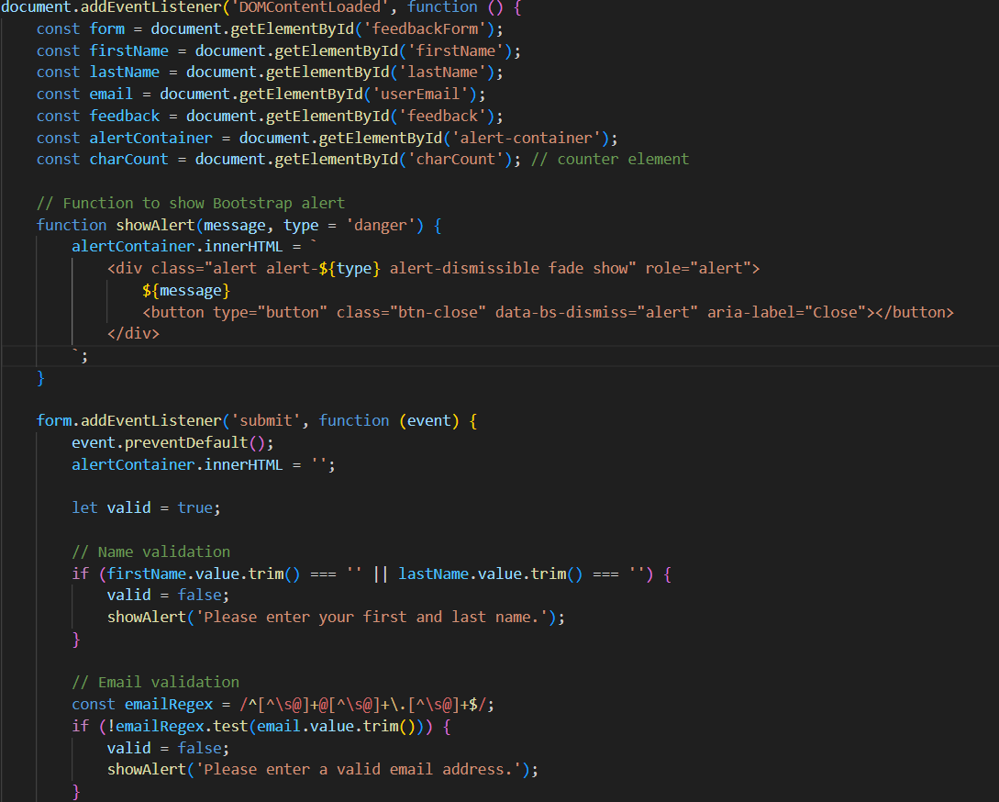
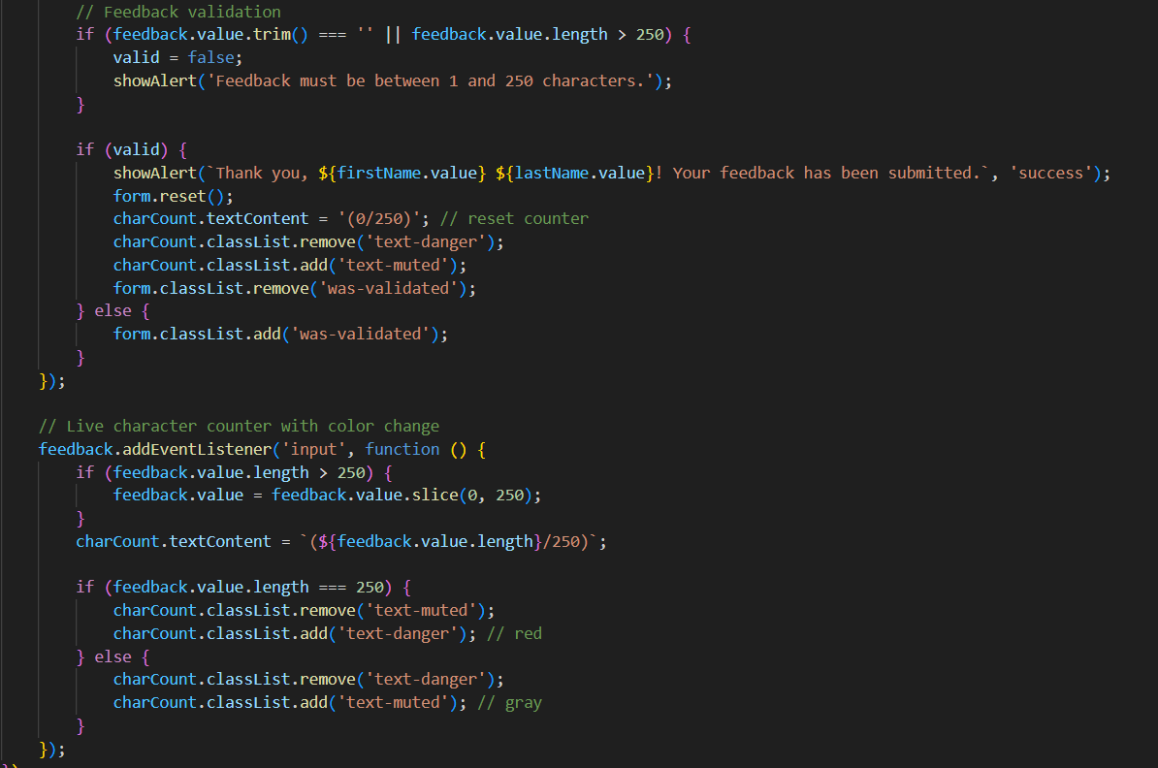
feedback_validate.js

Slide 24
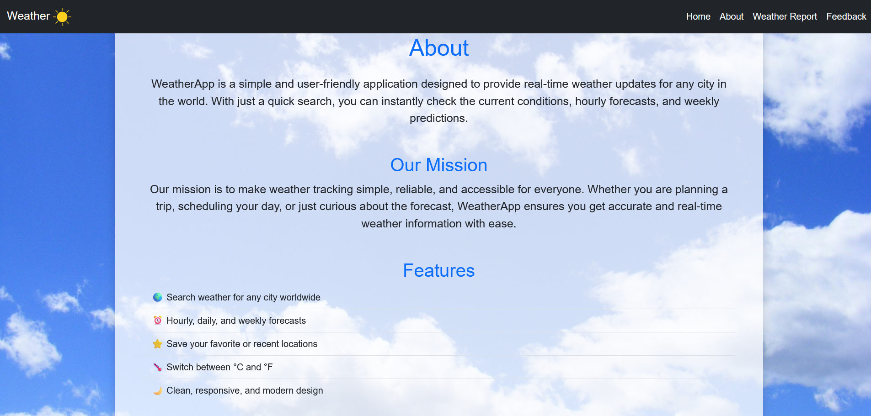
output

Slide 25
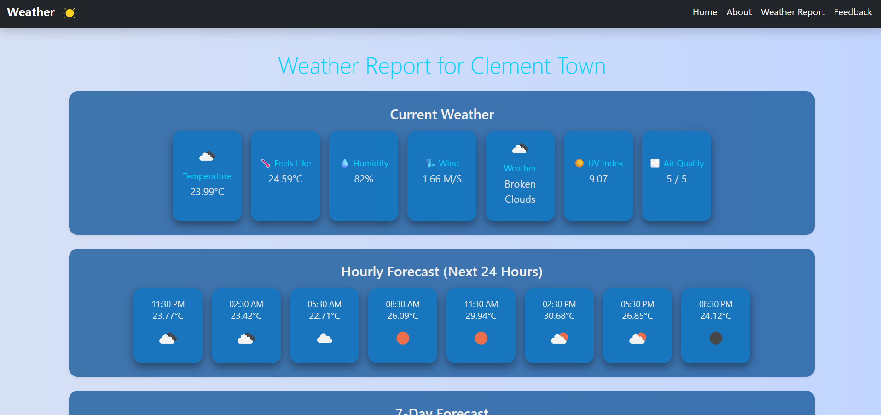
output

Slide 26
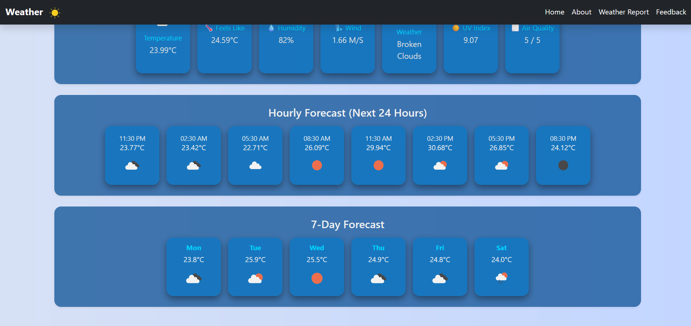
output

Slide 27
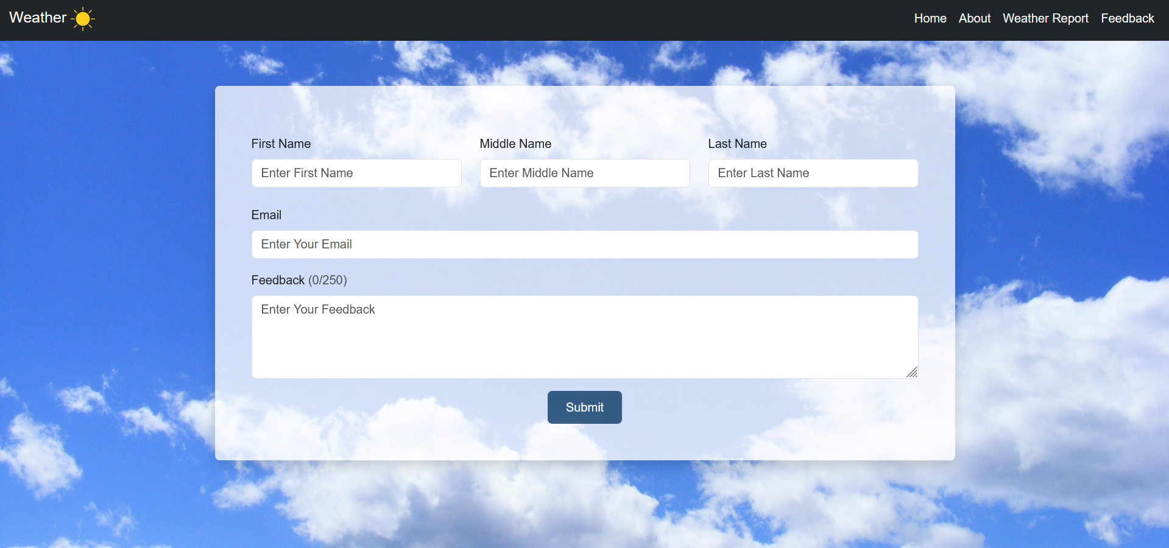
output

Slide 28
GITHUB AND DEPLOYMNET LINK
GitHub Link: https://github.com/ShivanshPuri122/weather
Deployment Link: https://shivanshpuri122.github.io/weather/

Slide 29
Conclusion
The Weather Dashboard provides real-time, location-based weather information in a clean and intuitive interface.
Users can access current conditions, hourly updates, and 7-day forecasts easily.
Geolocation and recent locations improve convenience and personalization.
The dashboard is responsive and cross-browser compatible, ensuring usability across devices.
Overall, it enhances daily planning and travel decisions with accurate, accessible weather data.

Slide 30
Future Scope
Add push notifications or alerts for severe weather conditions.
Integrate interactive weather maps to show regional conditions visually.
Support multiple languages for global accessibility.
Introduce custom themes or dark mode for better user experience.
Allow user-defined alerts for specific temperatures, rainfall, or air quality thresholds.

Slide 31
References
OpenWeatherMap API Documentation – Official documentation for accessing weather, forecast, UV, and air quality data: https://openweathermap.org/api
Bootstrap Documentation – For responsive layout, grid system, cards, buttons, and navigation components: https://getbootstrap.com
Geolocation API – Browser API reference for detecting user location: https://developer.mozilla.org/en-US/docs/Web/API/Geolocation_API
CSS Tricks – Tutorials and guides for styling responsive cards and layouts: https://css-tricks.com

Slide 32

Thank you
Shivansh Puri
shiwash122@gmail.com

